Slide 1
Gravity Method

Slide 2
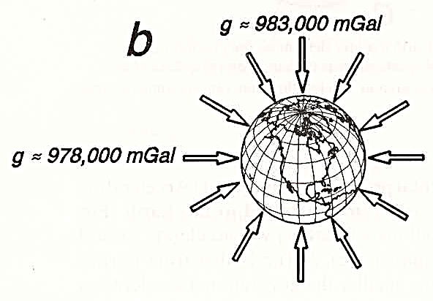
Potential field.
Strength and direction of field depend on position of observation within the field.
For gravity field, lines of are directed toward the center of the earth.

Slide 3
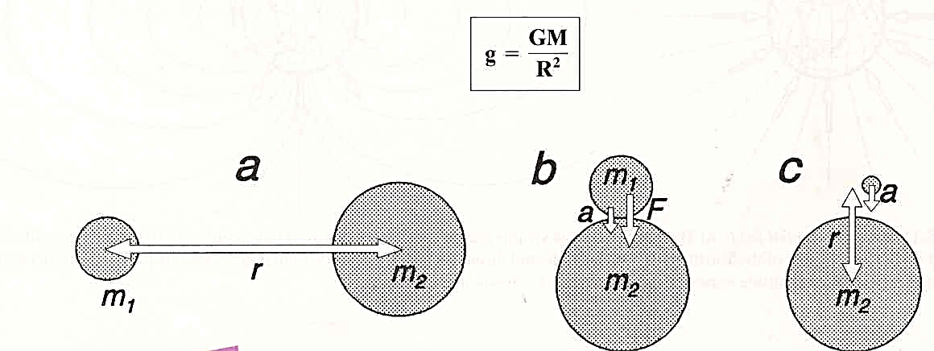
Earth’s Gravity Field
According to Newton's law: any two bodies that exist in nature between them have a force of attraction that is directly proportional to the product of the two masses and inversely proportional to the square of the distance between them.
F = G m₁m₂/r²
  F = force of attraction
  G = universal gravitational constant (6.67 x 10⁻¹¹ Nm²/kg²
  m₁ m₂ = mass of 2 objects
  r = distance between the centers of mass
  Note the units: F – Newton, m1 and m2 – kg, r -- meters

Slide 4
Earth’s Gravity Field
Gravitational acceleration is derived from Newton's second law of motion :
F = m₁a
  a= F/m₁
  F=G*m₁*m₂/R²
  a=Gm₂/R²
For the Earth, use g for gravity acceleration, M for its mass, we have:

Slide 5
When we assume that the Earth is perfectly spherical (with a radius R=6371 km), the gravitational acceleration can be estimated: Note: The Earth's mass is estimated at 5.9742 x 1024 kg.
Earth’s Gravity Field

Slide 6
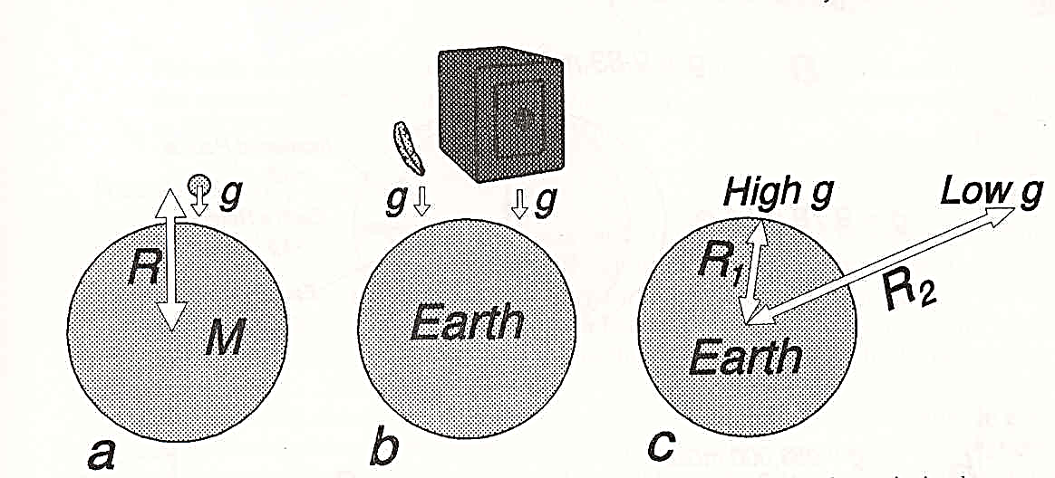
Earth’s Gravity Field
Considering that the Earth's mass and radius are constants, the gravitational acceleration of objects at the Earth's surface is estimated at 9.83 m/s2 The gravitational acceleration (g) on ​​the surface of the Earth is a constant amount, regardless of the mass of the object The farther an object is from the surface of the Earth, the less its gravitational acceleration (why: because of the increase in distance)

